Slide 1
4th_semester_status_update
Javier_Napoles
Notes:
This semester’s been kind of a mess with software. I kept running into connection issues, so I tried switching to Windows—but that just gave me more headaches. Eventually, I went back to my Mac, and finally, after some struggles, I got all the tools that I need for my project working. Here’s what I used…

Slide 2
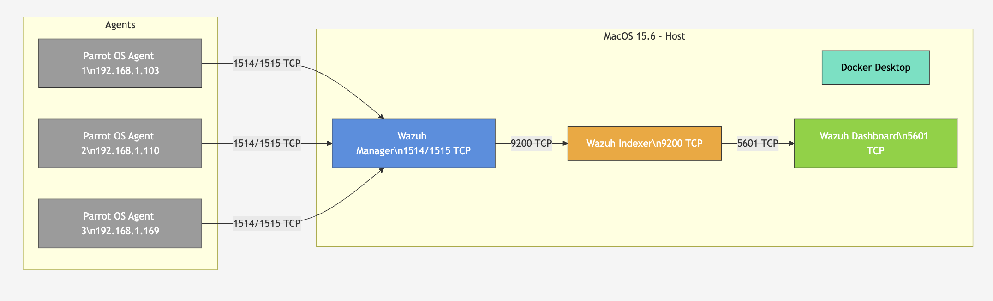
Project diagram
Notes:
This diagram shows our Wazuh home lab.
The Host runs MacOS with Docker Desktop.
Inside, we have the Wazuh Manager, Indexer, and Dashboard. Three Parrot OS agents connect to the manager on TCP ports 1514 and 1515 to send security events.
The manager sends logs to the indexer on port 9200. The dashboard retrieves them on port 5601 for visualization. Colors show roles: blue for manager, orange for indexer, green for dashboard, gray for agents. This makes the data flow clear and easy to understand.

Slide 3
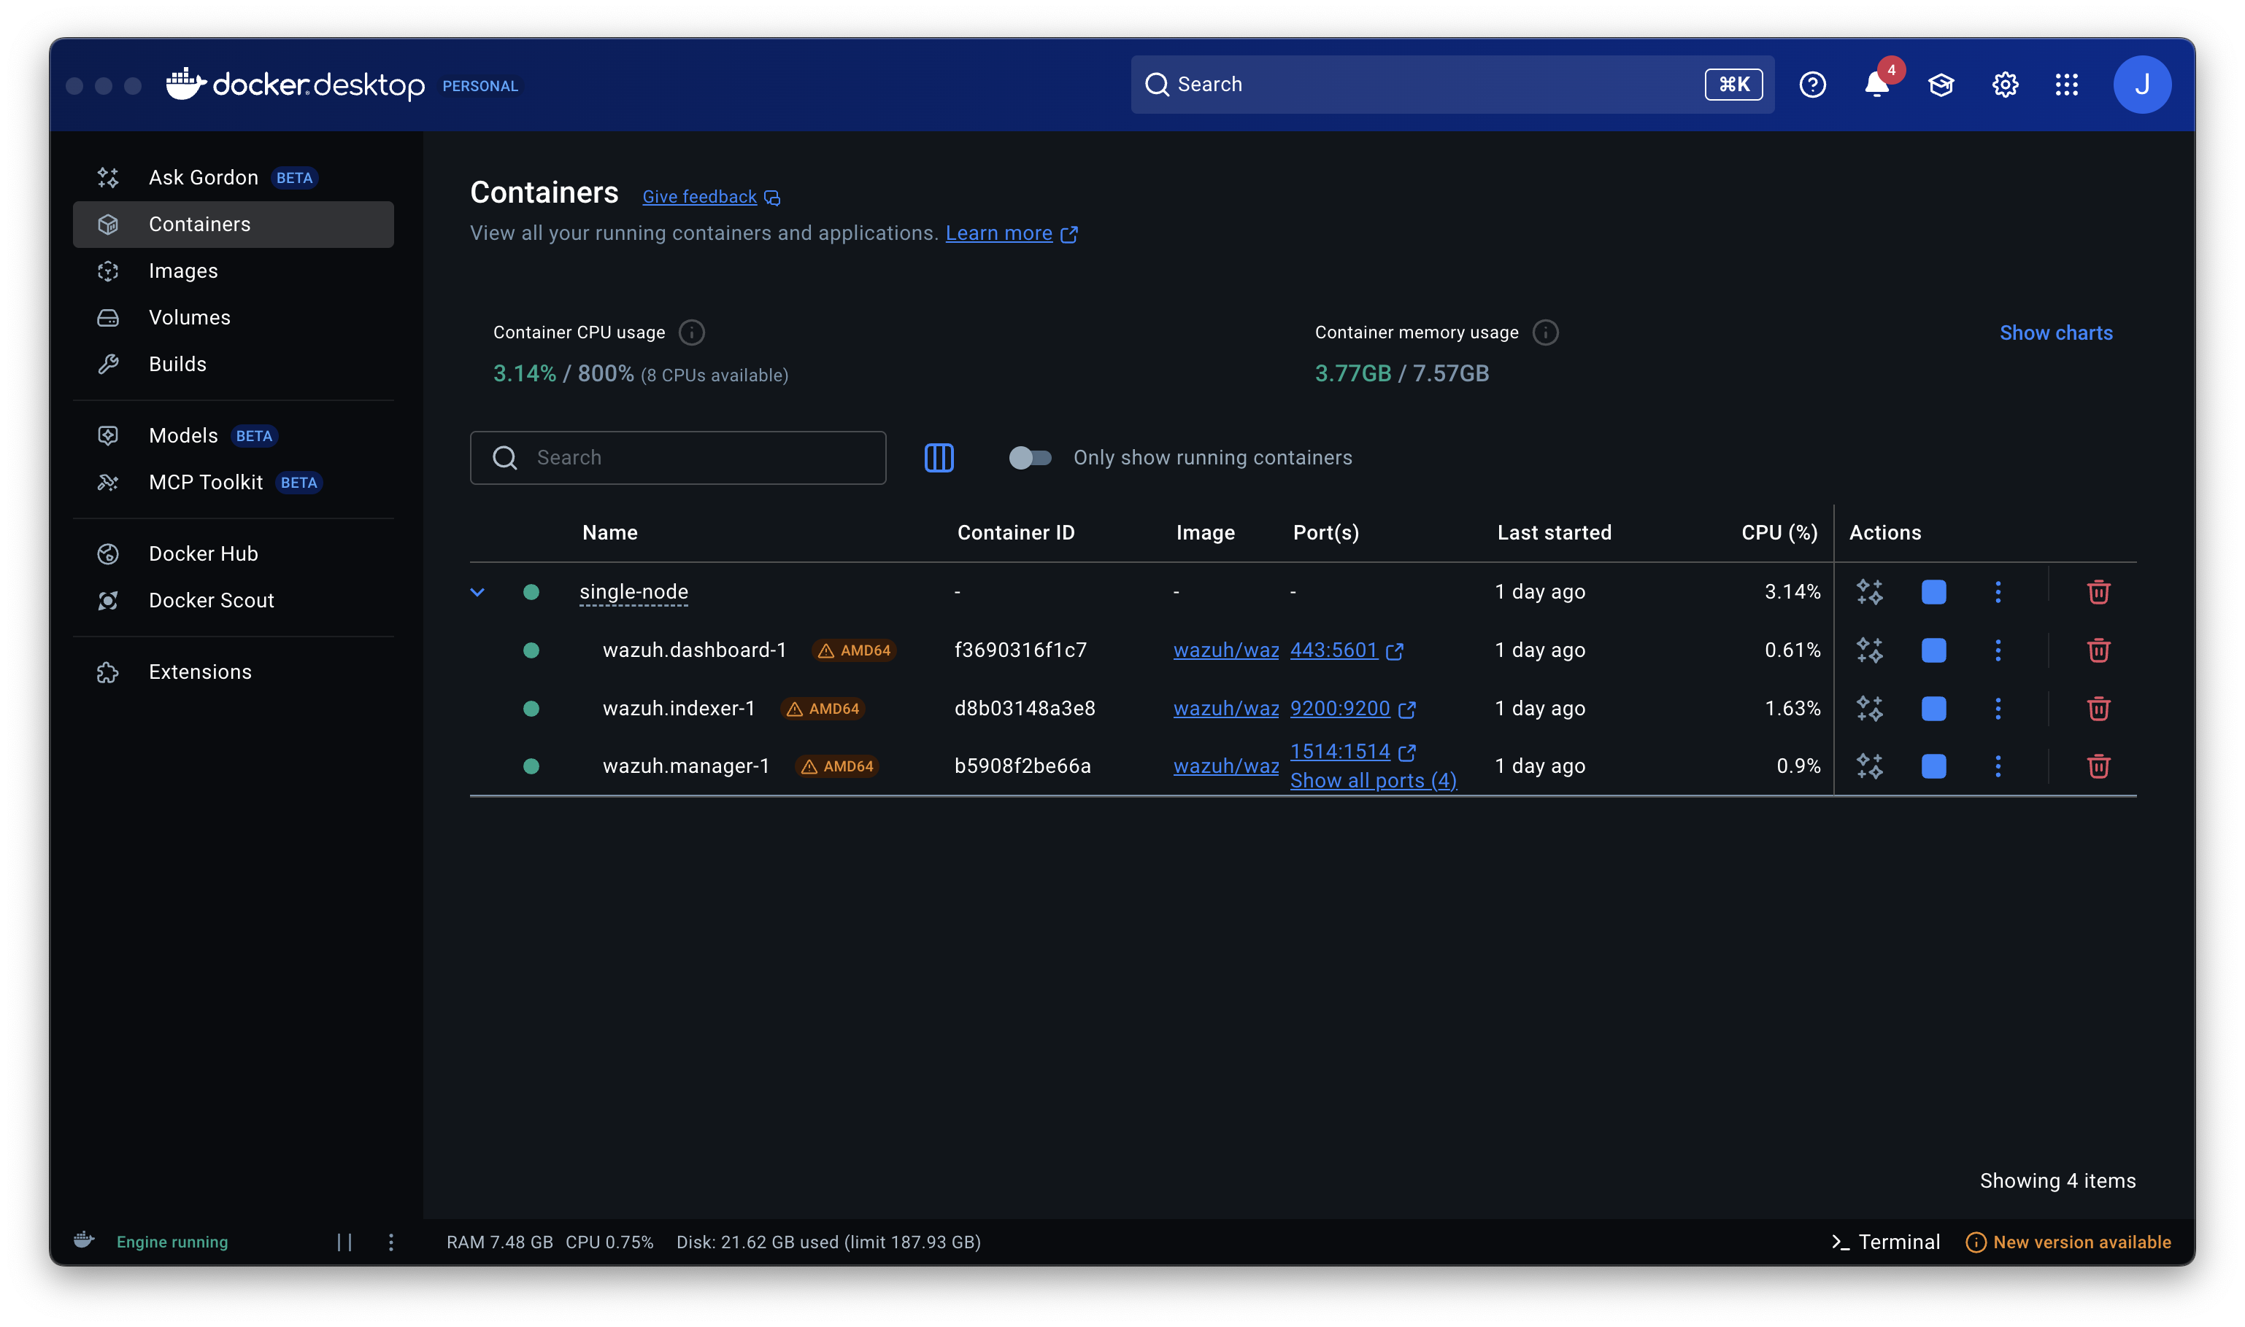
Notes:
In this Wazuh setup I use Docker containers to separate its main components.
The wazuh.manager is the core, it receives and analyzes logs from the agents.
The wazuh.indexer stores and organizes the data so it can be searched efficiently.
And the wazuh.dashboard gives us the web interface to visualize alerts and metrics. Running them in containers makes the system easier to manage, scale, and keep stable.”

Slide 4
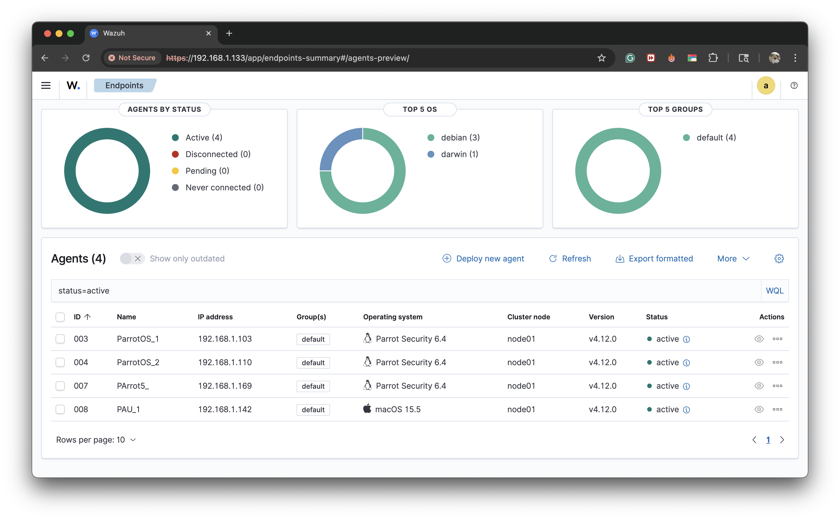
Notes:
“In this Wazuh dashboard we can see all of my active agents connected. I have three ParrotOS machines and one macOS system, all reporting logs to the Wazuh manager.
Each agent represents an endpoint, and having them active here confirms that communication is working. This allows me to monitor events from different operating systems in one place, making the lab environment more realistic and centralized.”

Slide 5
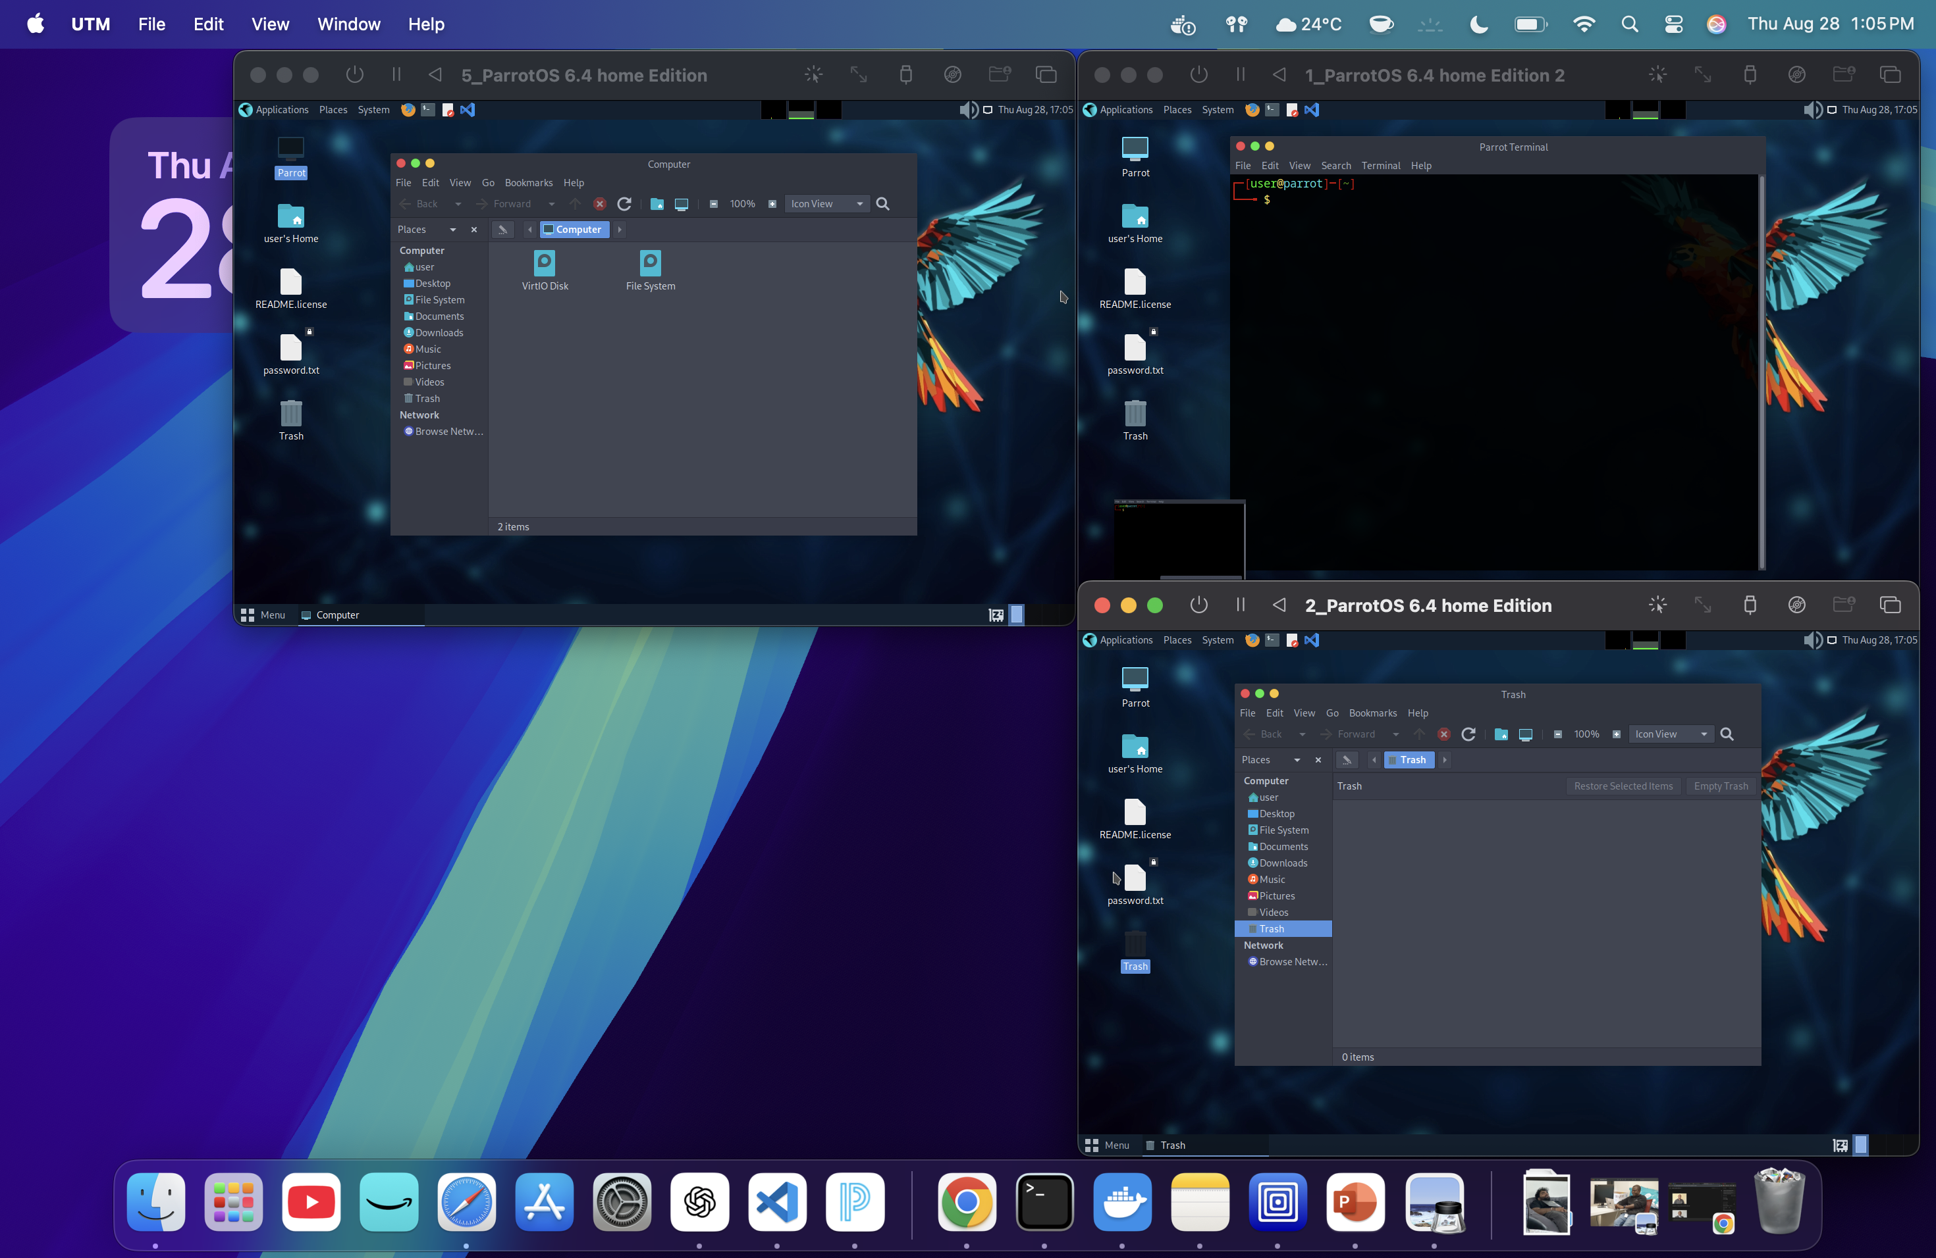
Notes:
“In this setup I’m running three ParrotOS virtual machines as Wazuh agents.
Each one simulates a different endpoint, and they can all communicate with each other as well as with the Wazuh manager.
This allows me to test log collection, rule detection, and incident response in a realistic lab environment, where I can see how multiple machines generate events and send them back to the central Wazuh system for analysis.

Slide 6
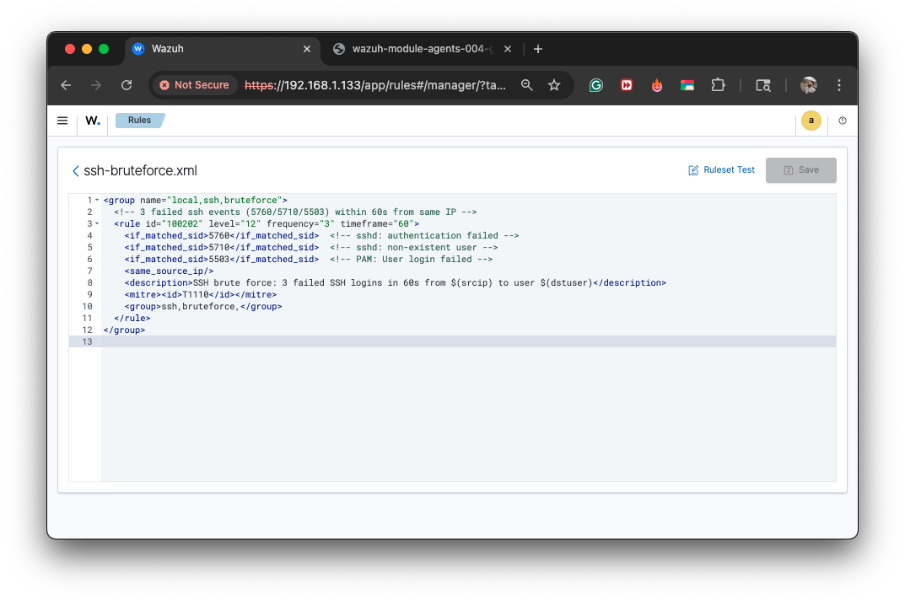
Notes:
This is a custom Wazuh rule I created to detect SSH brute force attempts. It looks for three failed login events within 60 seconds from the same IP address. If those conditions are met, the rule generates an alert with a high severity. By adding this rule, I can simulate real attack scenarios in my lab and see how Wazuh detects and reports them in the dashboard.”
ssh javierssh@192.168.1.110

Slide 7
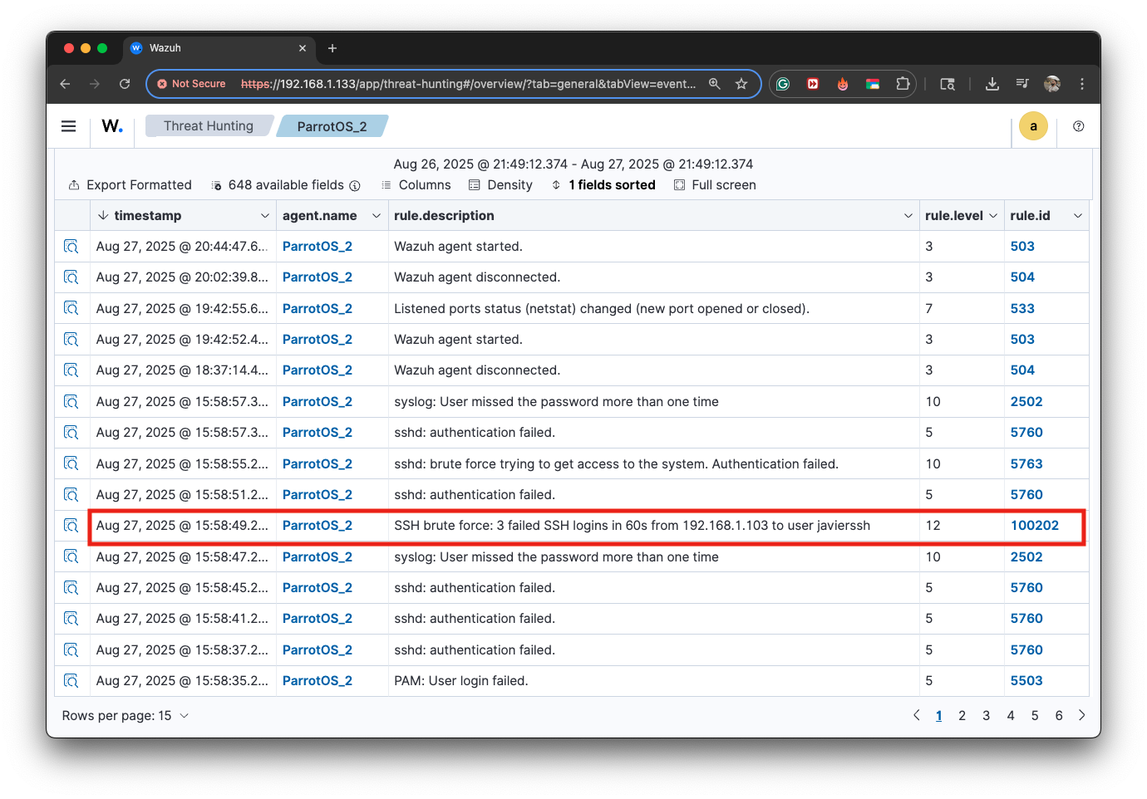
Notes:
“In this Threat Hunting view we can see the custom SSH brute force rule in action. The alert shows that three failed login attempts happened within 60 seconds, coming from the IP 192.168.1.103 to the user ‘javierssh.’ The rule triggered with a high severity level, confirming that Wazuh successfully detected the brute force attack and logged it for further analysis.
ssh javierssh@192.168.1.110

Slide 8
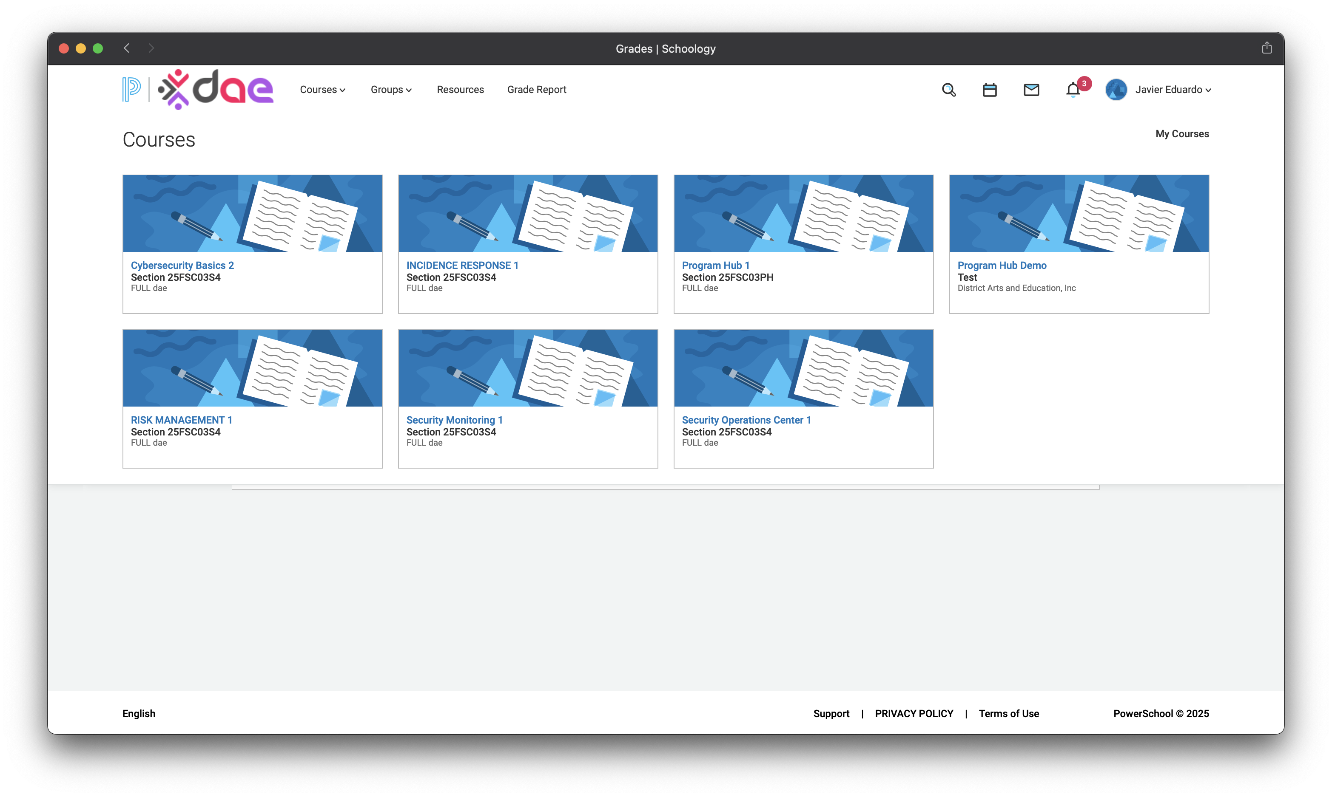
Notes:
Regarding DAE courses, I was able to finish them all.

Slide 9
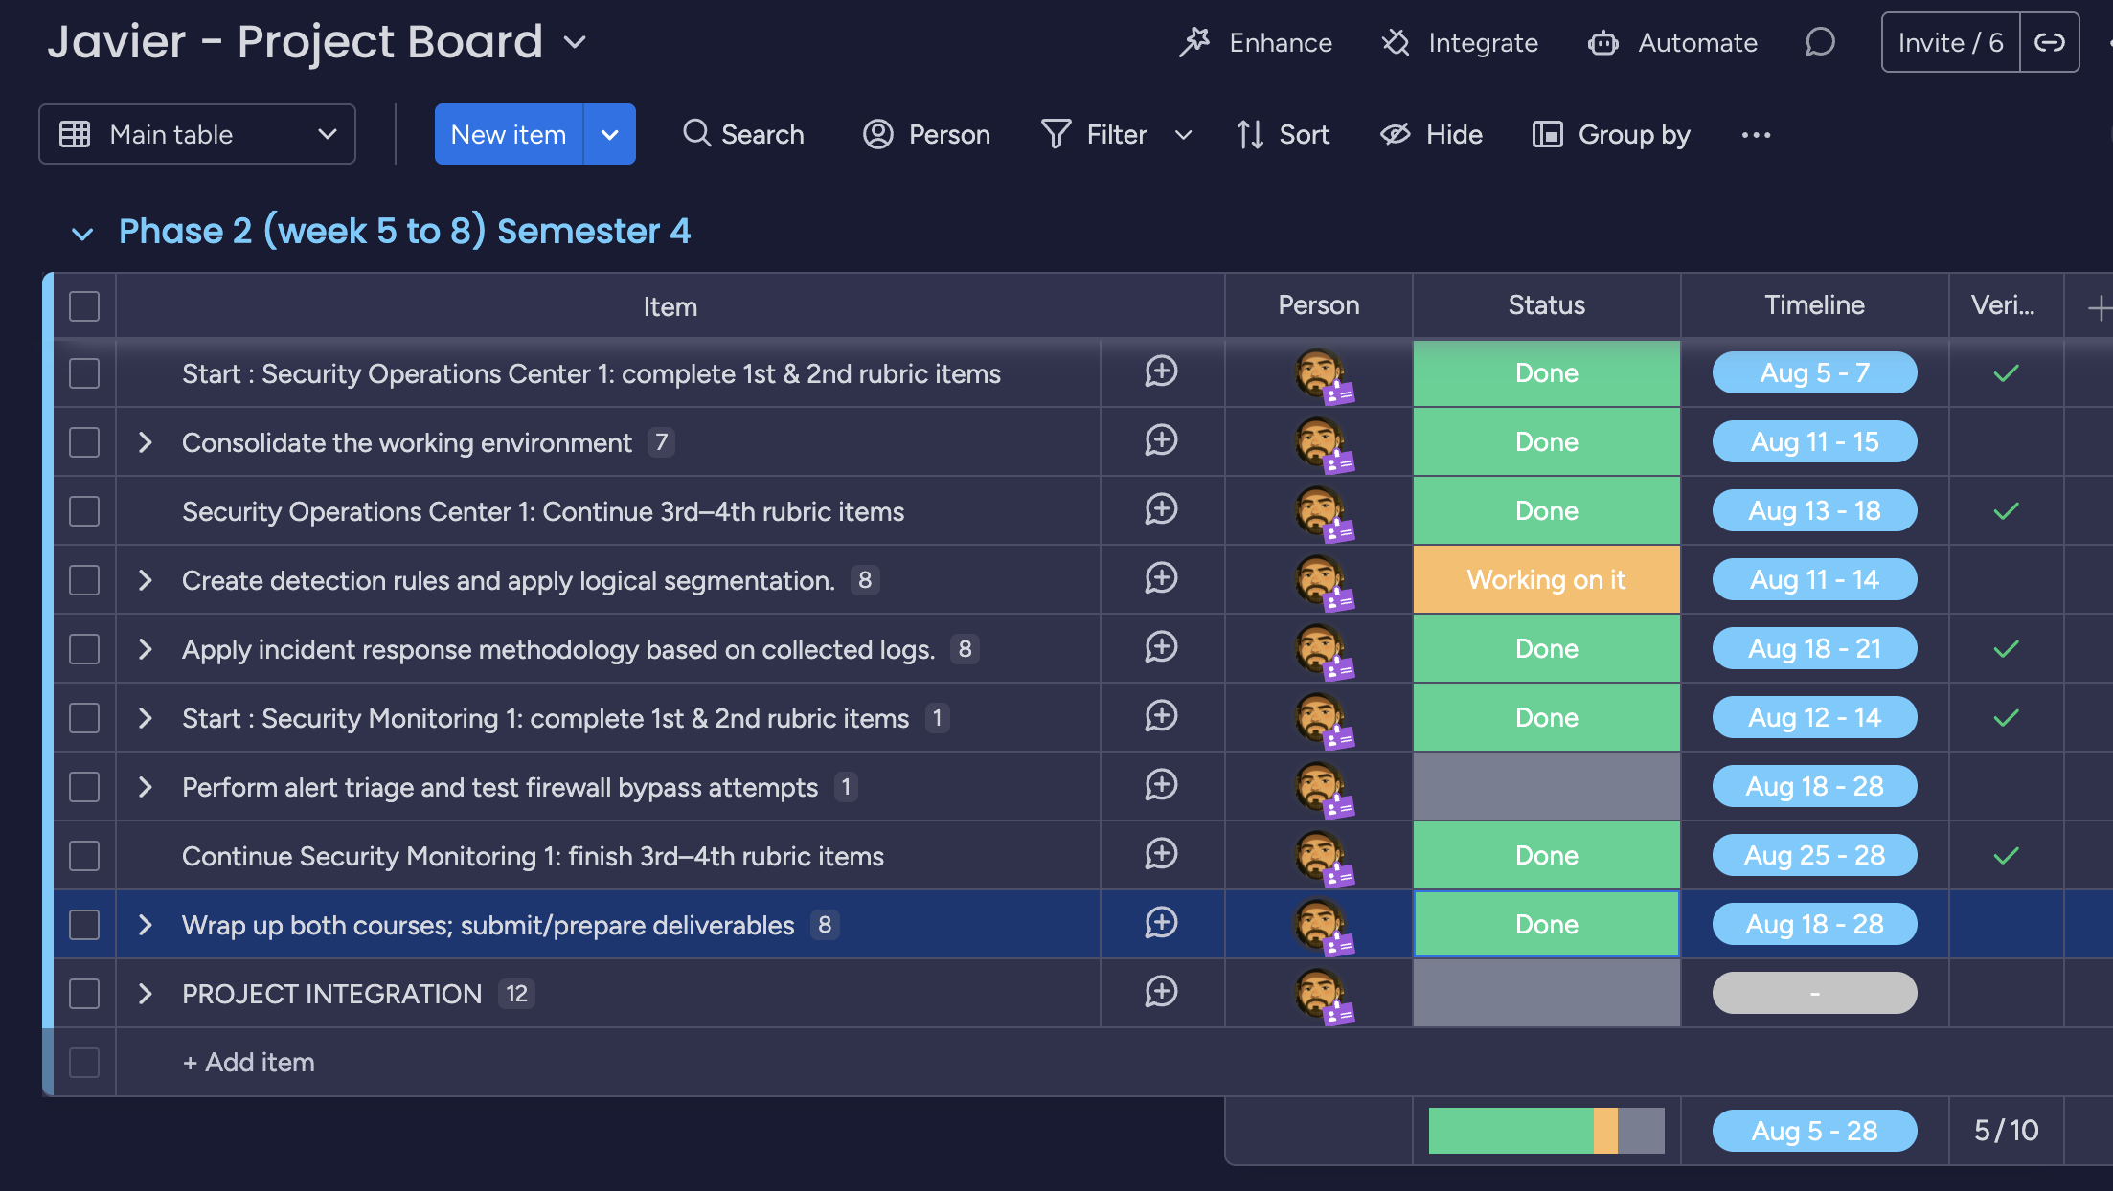
Notes:
"About Monday.com, I couldn’t finish all my tasks because of a troubleshooting marathon, so I’m just moving the ones I got done to next semester."

Slide 10

Thank You
Javier Napoles | jnapfx@gmail.com

